Slide 1
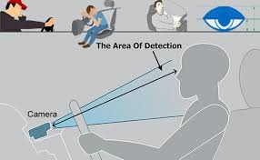

Drivers Drowsiness Detection System
Presented By:
Yashaswini Suryawanshi
Guided By:
Prof.S.G.Lade

Slide 2
Introduction
Driver’s Drowsiness Detection System is a car safety technology which helps to prevent accidents caused by the driver getting drowsy.
According to the National Highway Traffic Safety Administration, every year about 100,000 police-reported crashes involve drowsy driving. These crashes result in more than 1,550 fatalities and 71,000 injuries. The real number may be much higher, however, as it is difficult to determine whether a driver was drowsy at the time of a crash.
To avoid this conditions, I am trying to make driver's life as well as traveler's life easy by integrating a live detection system in running vehicle on road. Driver Drowsiness Detection System (D3S).

Slide 3
Objectives
To build up a drowsiness recognition system which recognizes drowsy driver to forestall mishap.
Improve security on streets.
Drowsiness Detection & Alert.
Developing Web-Application for this System.

Slide 4
Literature Survey
Various technologies can be used to try to detect driver drowsiness.
Steering pattern monitoring
Vehicle position in lane monitoring
Driver eye/face monitoring
Physiological measurement

Slide 5
Scope
D3 System will diminish the vehicle street mishap.
Save more lives from Car/Vehicle Accidents.
For enhancing security of driver.

Slide 6
Problem Analysis
Algorithm:
Complete project is combined of 3 stages:
1)Face Detection
2)Eye-Blink Detection And Yawn Detection with Alarm Generation
3)Flask Embedding

Slide 7
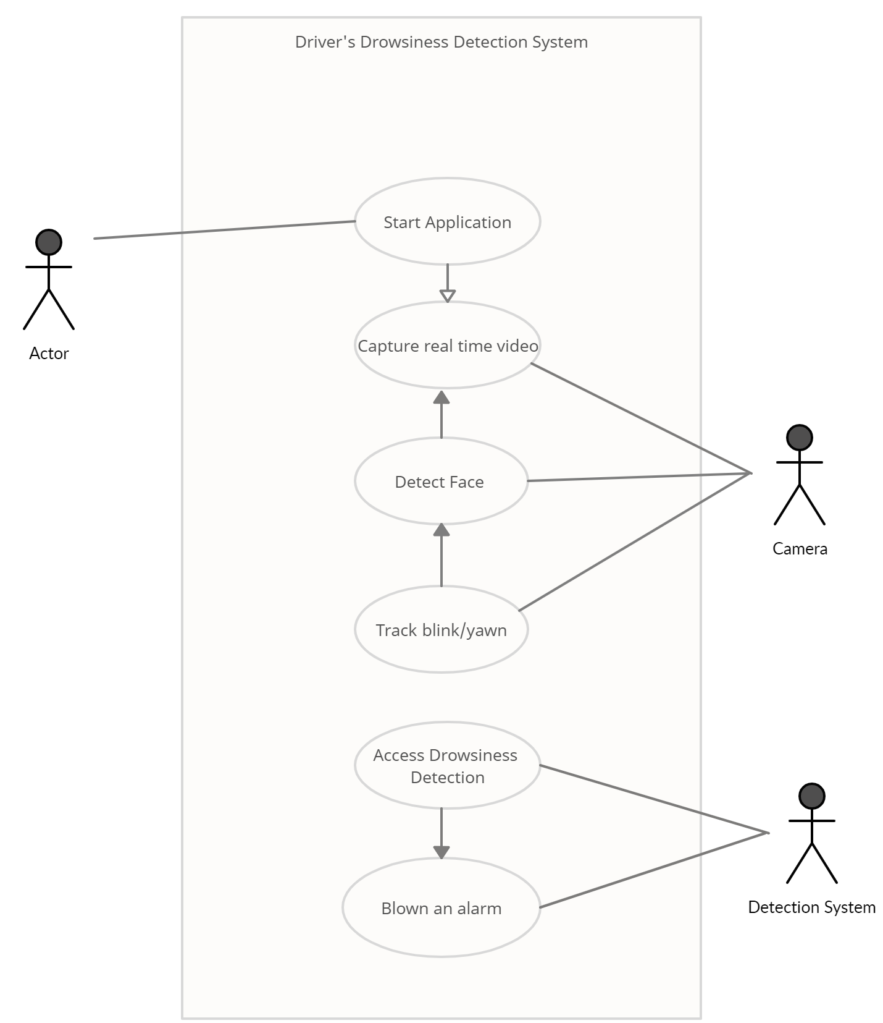
System use case
Driver

Slide 8
Project Idea/Proposed Work
This project involves controlling vehicle accidents and saving drivers life by alerting him/her on time.
Whenever drivers eye blinking period is more than particular time then we consider this condition under drowsiness.
Immediate action will be taken and buzzer will be immediately triggered to alert and wake-up driver.
Development is done in Python ,C ,HTML ,CSS , JavaScript.

Slide 9
Project Flow:
Face Detection
Calculate Blink Ratio & Yawn Ratio
Embed All Code to Flask
Hosting Web Application
Get Landmarks for eye & mouth
Generate Alarm
Capturing Options:
1.WebCam 2.Mobile Cam
3.Portable Webcam

Slide 10
Solution Realization
The speedy detection and process of information is the main aim of my system.
Following are successive stages of project:
1)Face Detection
2)Eye & Lips Region Extraction
3)Eye-Blink Detection And Yawn Detection
4)Alarm Generation
5)Flask Embedding

Slide 11
Face Detection
It covers points ranging from training ,testing and classifying model.
Face Detection
Training Dataset
Viola Jones Algorithm
Testing Dataset
Haar Features
Integral Image
Adaboost
Cascade
Fig. 1.Face Detection

Slide 12
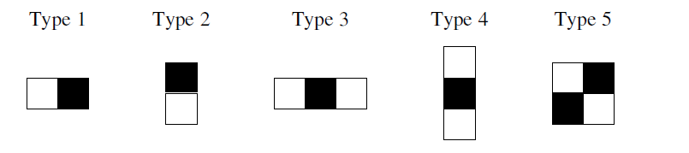
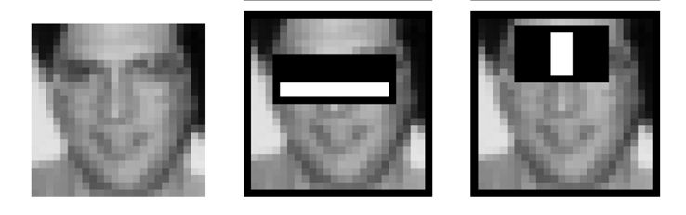
Haar Features
Haar features are similar to these convolution kernels which are used to detect the presence of that feature in the given image.
Haar features used in viola Jones Applied on given image
Fig 2. Haar Features and its implementation

Slide 13
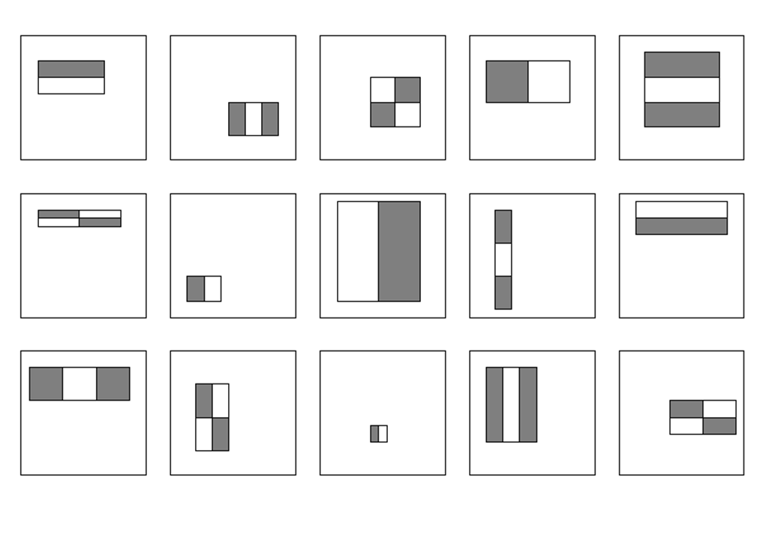
Haar Features
Viola jones algorithm uses a 24x24 window as the base window size to start evaluating these features in any given image.
If we consider all possible parameters of the haar features like position, scale and type we end up calculating about 160,000+ features in this window.
Fig 3. Haar Features

Slide 14
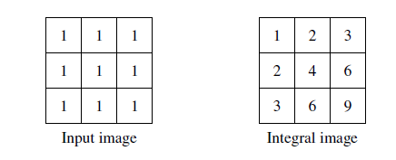
Integral Image
In an integral image the value at pixel (x,y) is the sum of pixels above and to the left of (x,y)
Sum above and to left
Fig 4. Integral Image

Slide 15
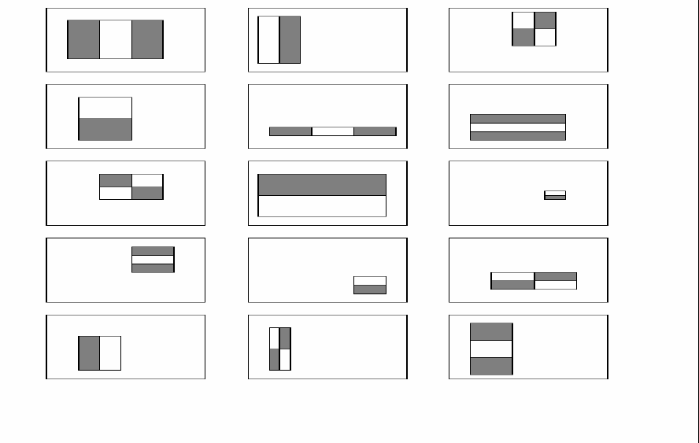
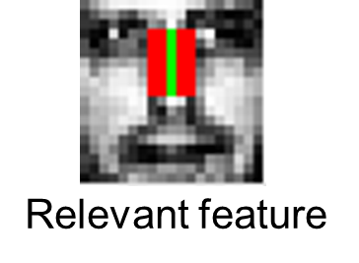
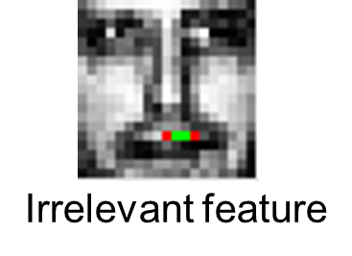
Adaboost
As stated previously there can be approximately 160,000 + feature values within a detector at 24x24 base resolution which need to be calculated. But it is to be understood that only few set of features will be useful among all these features to identify a face.
All Features Relevant Features Irrelevant Features
Fig.5. Adaboost algorithm application using haar feature

Slide 16

Adaboost
Adaboost is a machine learning algorithm which helps in finding only the best features among all these 160,000+ features.
After these features are found a weighted combination of all these features in used in evaluating and deciding any given window has a face or not.
Fig.6. Adaboost

Slide 17
Cascading
The basic principle of the Viola-Jones face detection algorithm is to scan the detector many times through the same image – each time with a new size.
Even if an image should contain one or more faces it is obvious that an excessive large amount of the evaluated sub-windows would still be negatives (non-faces).
So the algorithm should concentrate on discarding non-faces quickly and spend more on time on probable face regions.
Hence a single strong classifier formed out of linear combination of all best features is not a good to evaluate on each window because of computation cost.

Slide 18
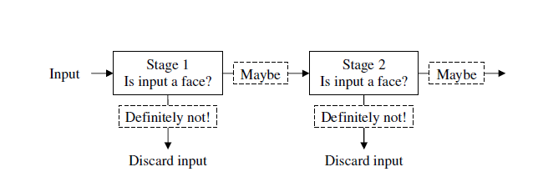
Cascading
Therefore a cascade classifier is used which is composed of stages .
Where , The job of each stage is used to determine whether a given sub window is definitely not a face or may be a face. A given sub window is immediately discarded as not a face if it fails in any of the stage.
Fig.7. Cascading

Slide 19
Eye & Lips Region Extraction
Once the face is detected, now comes the task to detect the facial landmarks in the face using the dlib’s landmark predictor.
The landmark predictor returns 68 (x, y) coordinates representing different regions of the face, namely –
Mouth
Left eyebrow
Right eyebrow
Right eye
Left eye
Nose & Jaw.

Slide 20
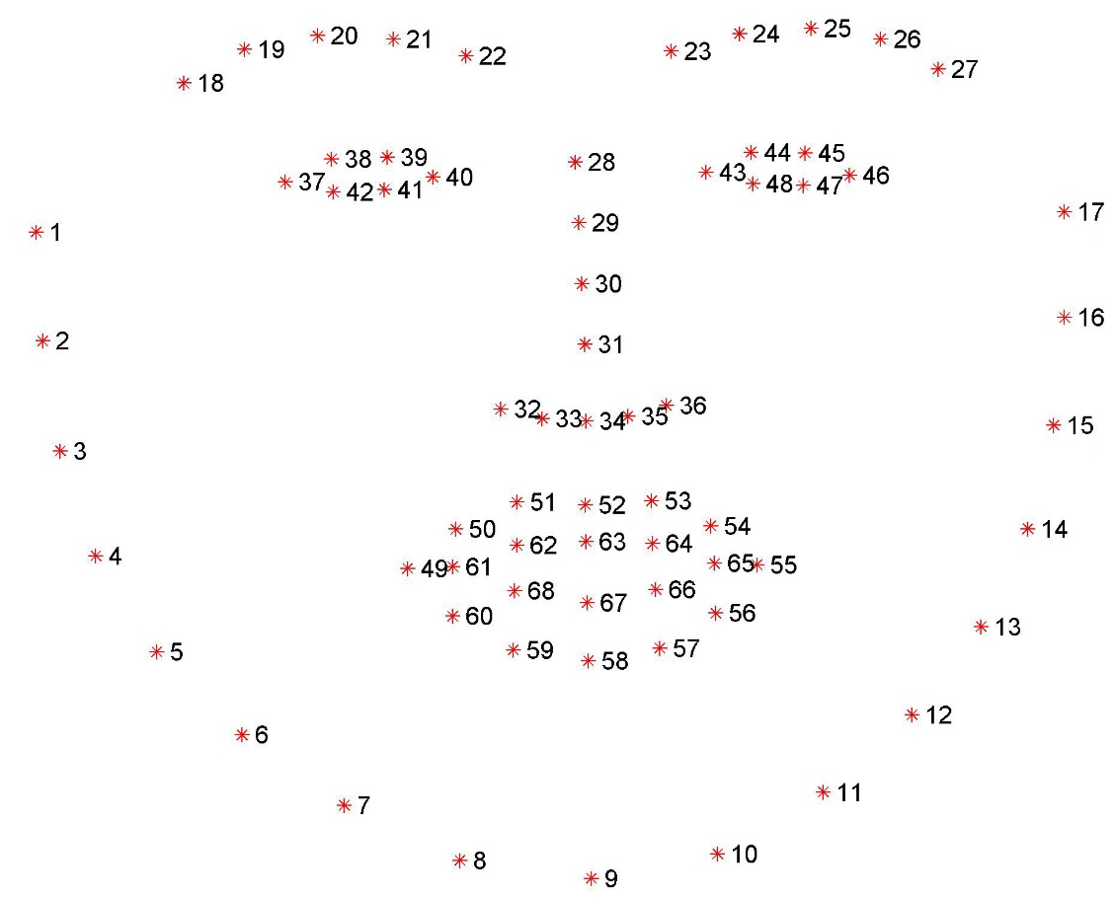
Facial Landmark
Fig.8. 68 Facial Landmark

Slide 21
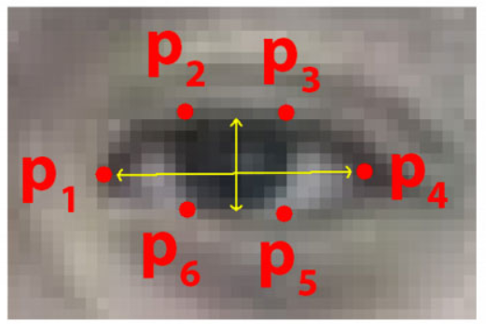
Eye Region Extraction
Extract the Cartesian coordinates
Fig.9. Eye Coordinates

Slide 22
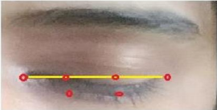
Eye Blink Detection
Now that we have detected eyes, let’s focus on detecting blinks.
We are going to use the horizontal length to vertical length ratio of the imaginary bounding box of the eye. This will be the blink ratio.
Fig.10. Blink

Slide 23
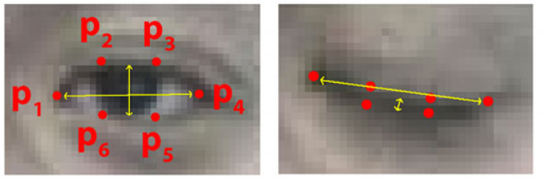
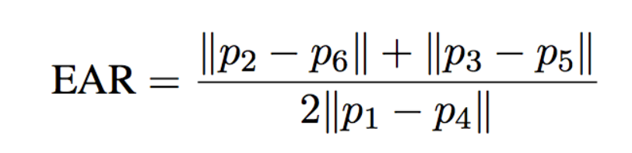
Eye Blink Classification

Slide 24
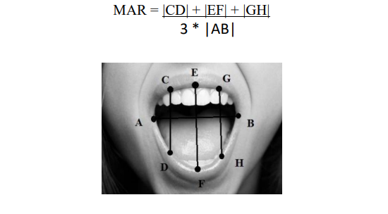
Mouth Region Extraction & Yawn Detection
Fig.11. MAR

Slide 25
Alarm Generation
EAR = (A + B) / (2.0 * C)
EAR < = 0.2 ,Blink is detected hence alarm gets triggered.
MAR>14,Yawn is detected hence alarm gets triggered.

Slide 26
Implementation Details

Slide 27

Flask:
Flask is a micro web framework written in Python.
It is classified as a microframework because it does not require particular tools or libraries.
It has no database abstraction layer, form validation, or any other components where pre-existing third-party libraries provide common functions.

Slide 28
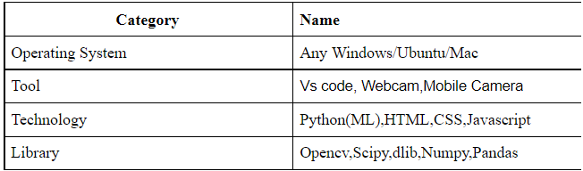
System Specification

Slide 29
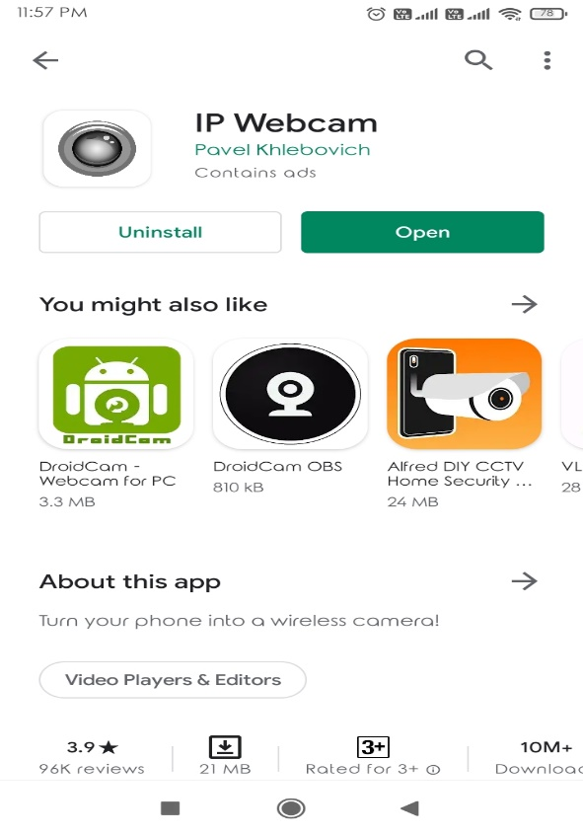
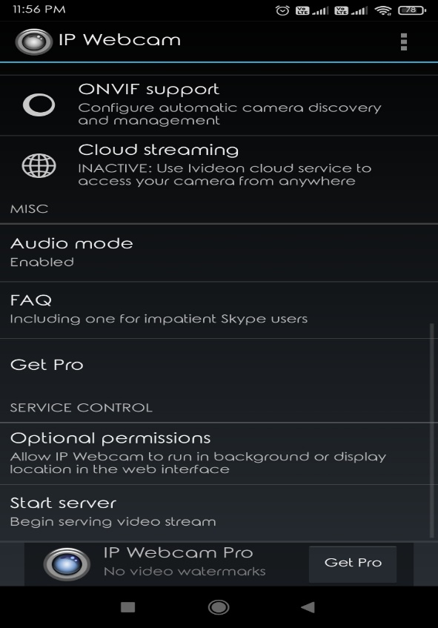
IP WebCam

Slide 30
System Flowchart

Slide 31
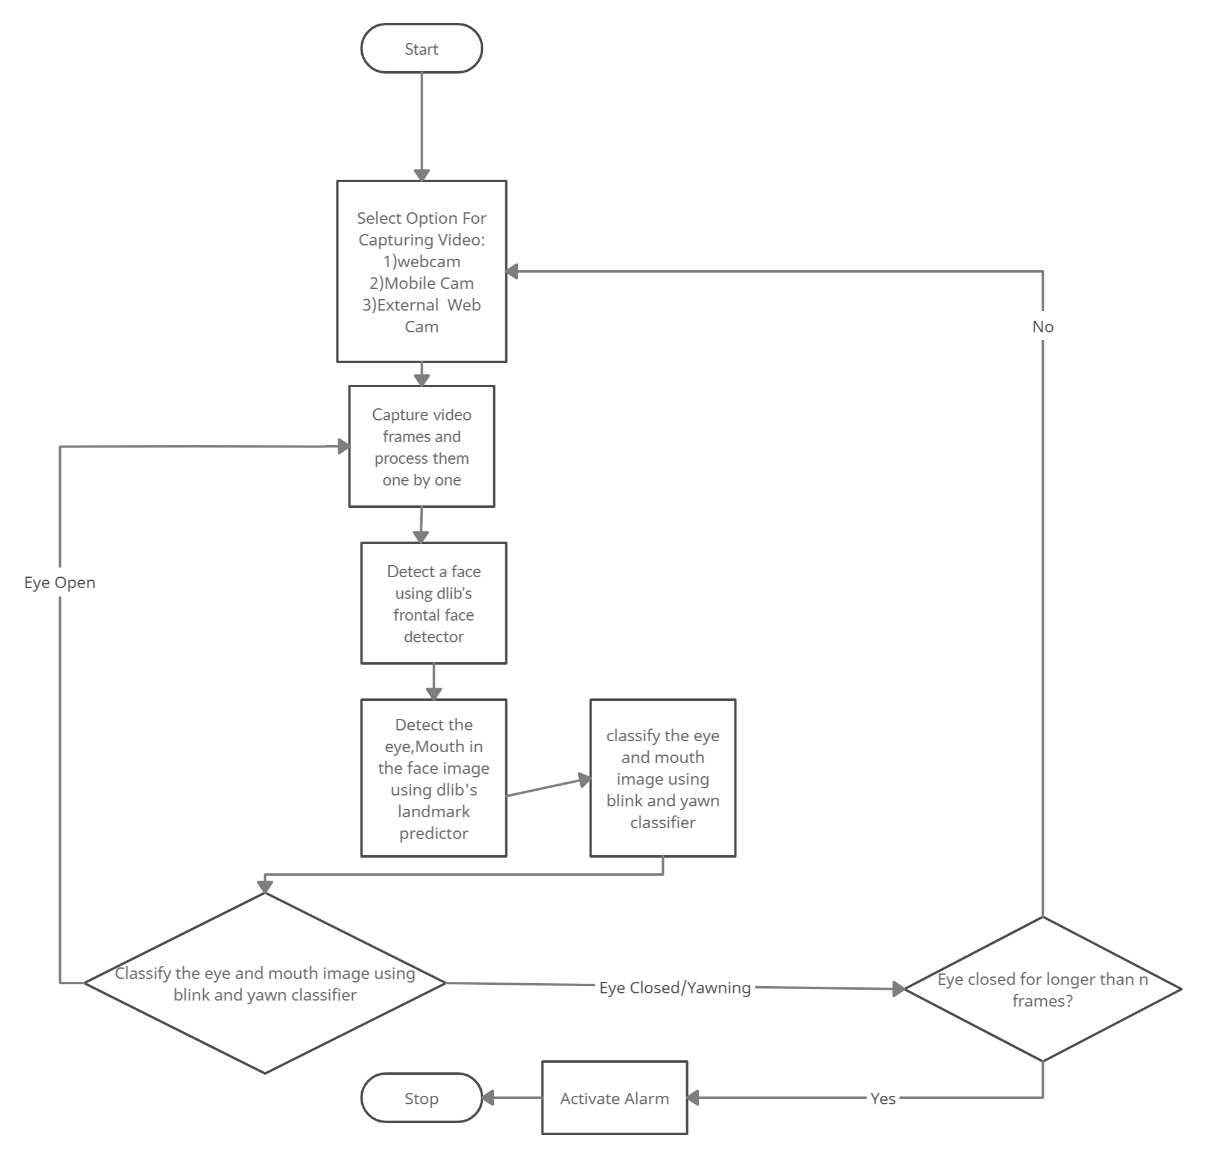
Fig.12. System Flowchart

Slide 32
Results

Slide 33
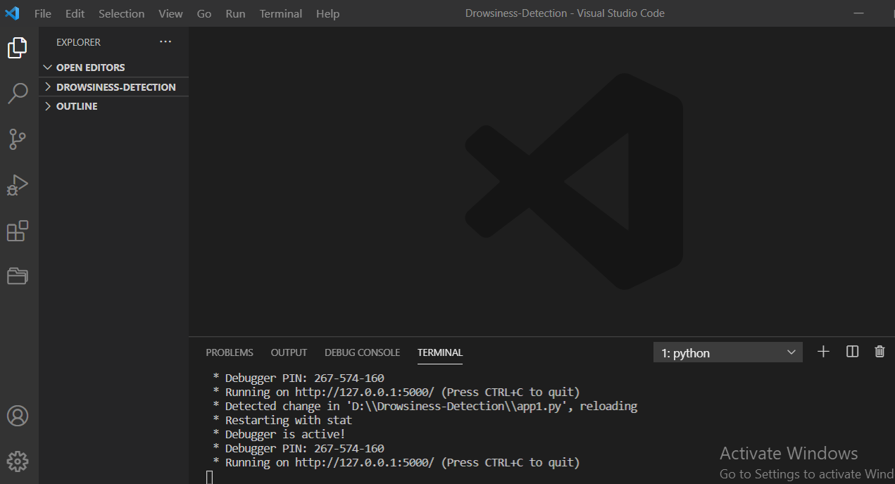
VScode IDE to invoke server

Slide 34
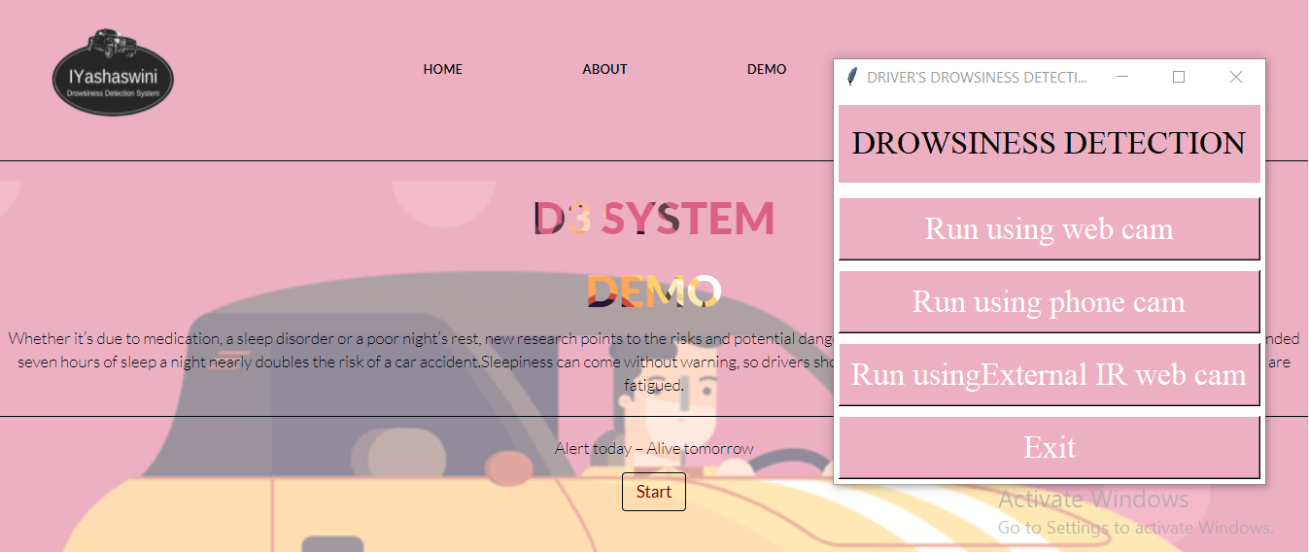
Device Selection Window

Slide 35
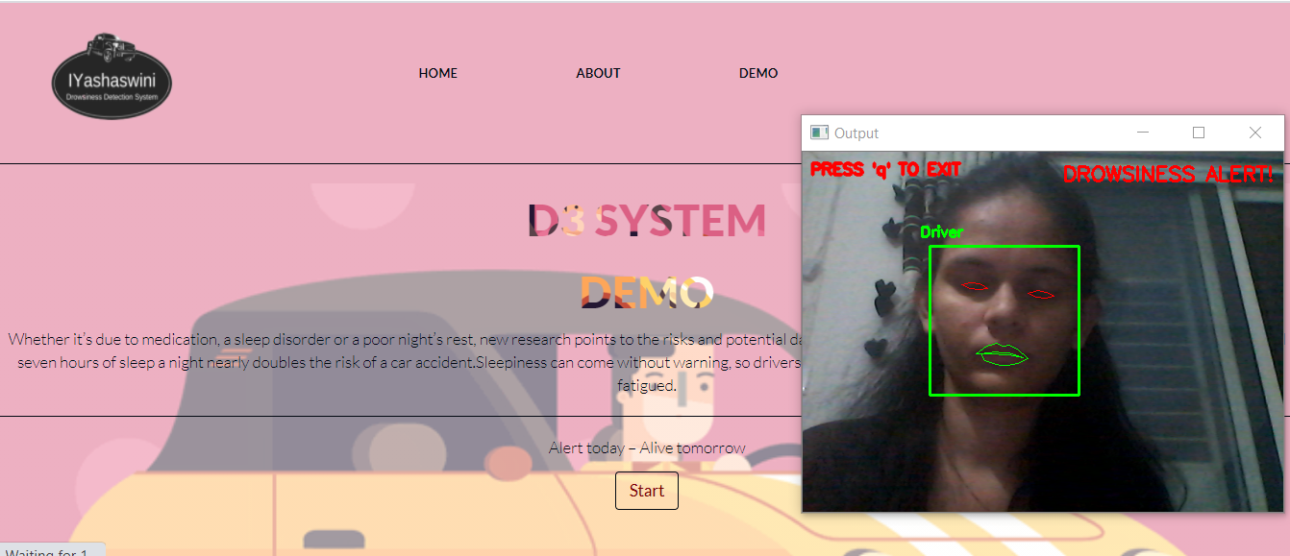
Drowsiness Detection Using WebCam

Slide 36
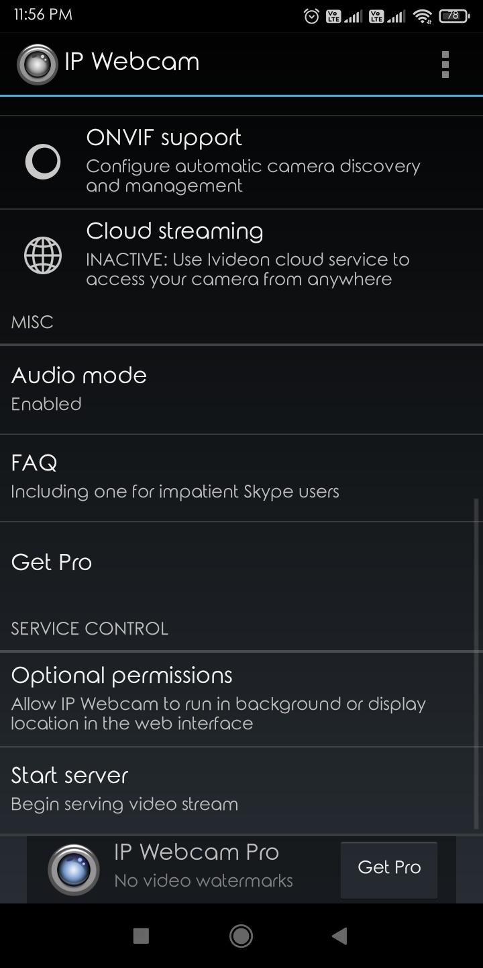
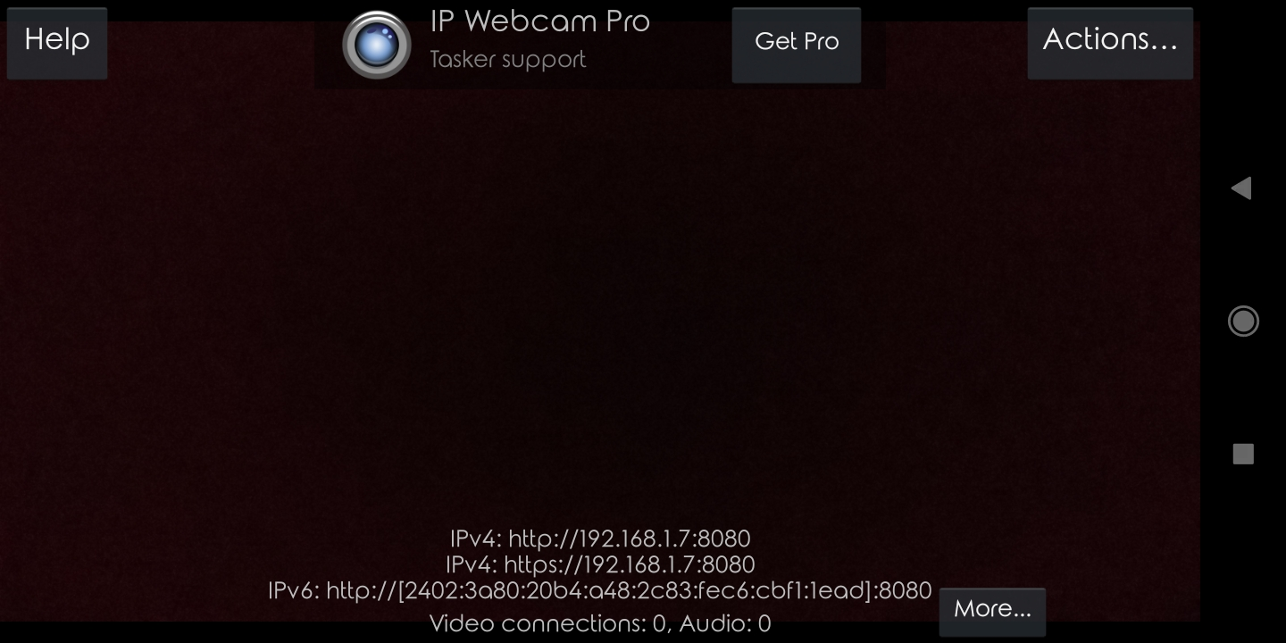
IP WebCam Setup

Slide 37
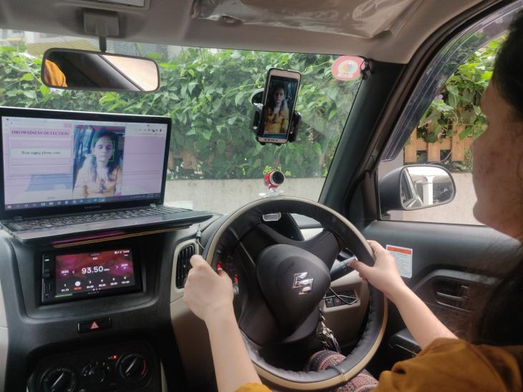
Drowsiness Detection Using Mobile cam

Slide 38
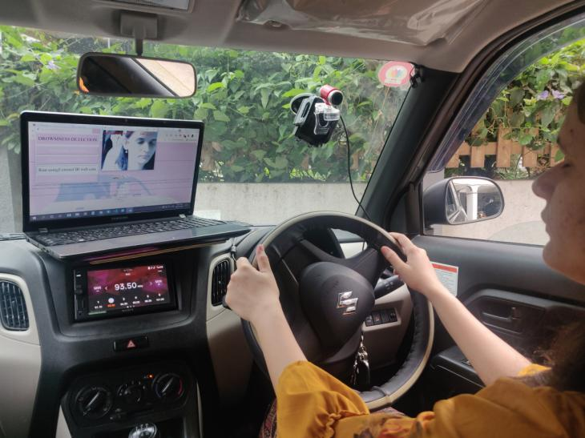
Drowsiness Detection Using External Webcam

Slide 39

Have a look at Demo

Slide 40

Thank You

